Slide 1
Capstone Project
Identifying Restaurant Location in London City

Slide 2
Introduction
Identify specific area and location, where a restaurant might be of interest for stakeholders in London city.
The exercise is based on lessons learnt in the Data Science course and the Berlin City example.
The output of the project is to provide probable addresses where a stakeholder can begin their search.

Slide 3
Data Sources and packages used
The neighbourhood and borough locations have been scrapped Wikipedia https://en.wikipedia.org/wiki/List_of_areas_of_London
The borough boundaries have been taken from https://github.com/martinjc/UK-GeoJSON/blob/master/json/administrative/eng/lad.json
Restaurants data have been taken form Foursquare
Python Packages – BeautifulSoup, Pandas, Folium, Geopy, UTM and Sklearn

Slide 4
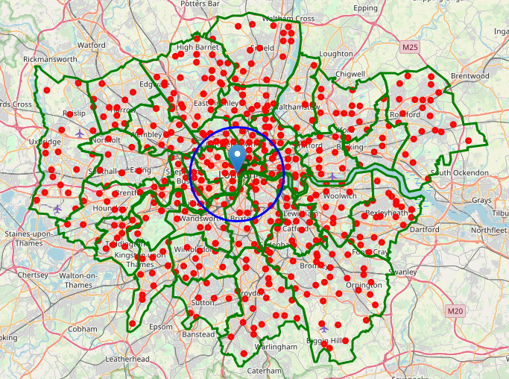
London Borough Map
Borough Boundaries (green)
Neighbourhoods (red)
Analysis region 6000m (blue)

Slide 5
Methodology
Divide the interested region into several areas.
Search for all restaurants in the areas.
Identify the density of restaurants and pick a region with least restaurant density.
Run the Kmeans clustering algorithm to identify cluster centres, which become the candidates of search.

Slide 6
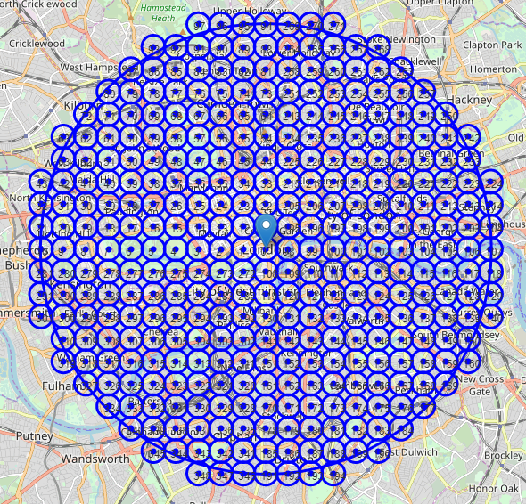
Division of Region of Interest
349 areas of study
Each with a radius of 300m

Slide 7
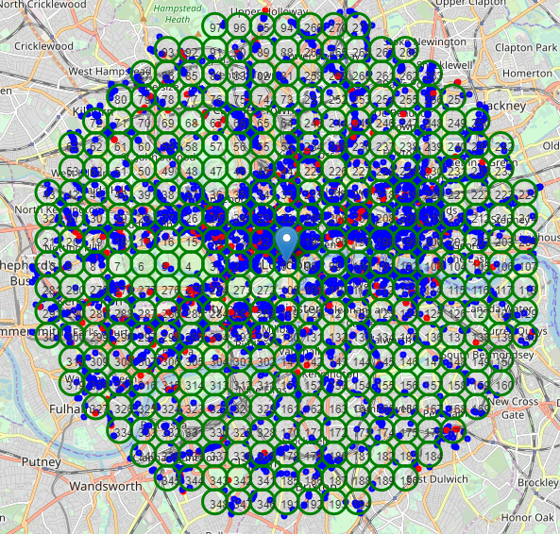
Foursquare Data
About 5400 restaurants (blue)
About 430 Italian restaurants (red)
South east region has least density.

Slide 8
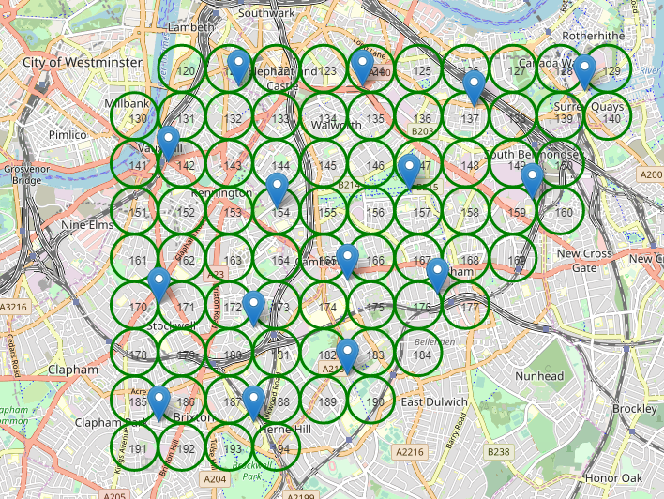
Clustering Algorithm
Applied to areas 120 to 194
15 clusters centres identified

Slide 9
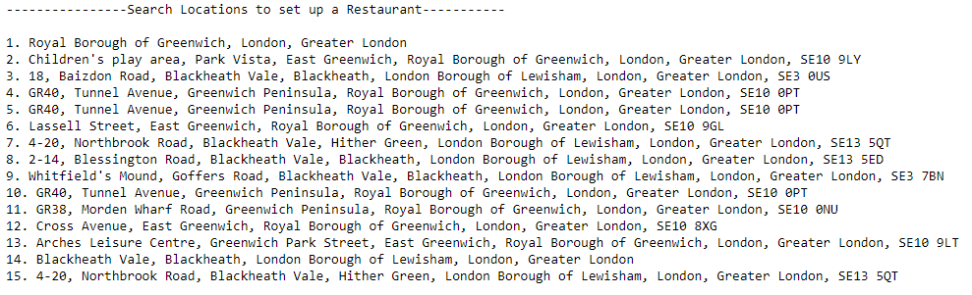
Probable Search Locations

Slide 10
Conclusion
Royal Borough of Greenwich and London Borough of Lewisham are good boroughs to search for a restaurant location.
Future Scope:
The analysis was based on restaurant density only. This can be extended to add population and income layers to the existing one to get a complete picture.
Identify specific cuisine restaurant.

